Slide 1

CSIT-100_08
April 9, 2026
AI IN
MEDICINE
Created by: Himani Batham

Slide 2
ARTIFICIAL INTELLIGENCE
Artificial Intelligence refers to computer systems which is designed to perform tasks that normally requires human intelligence such as learning, reasoning, pattern recognition and decision making.

Slide 3

INTRODUCTION
AI is transforming healthcare by improving efficiency, accuracy, and access.
It helps analyze large amounts of medical data quickly.
AI supports doctors in diagnosing diseases and making better decisions.
It is a tool to assist—not replace—healthcare professionals.
Did you know?
Nearly two-third (66%) of US physicians reported using AI in 2024, a 78% increase from 2023.
60% of US hospitals use AI-driven predictive models.

Slide 4
HISTORY AND DEVELOPMENT
The development of machine learning algorithms allowed computers to learn from data. With the rise of electronic health records, large databases of patient information became available for analysis.
In 1960s and 1970s an early computer program were developed called MYCIN, which identified bacterial infection and recommend antibiotics.
Deep Learning models can now help analyze complex patterns in images, particulary useful for X-rays, CT scans and MRIs.

Slide 5
APPLICATIONS OF AI IN MEDICINE

Slide 6
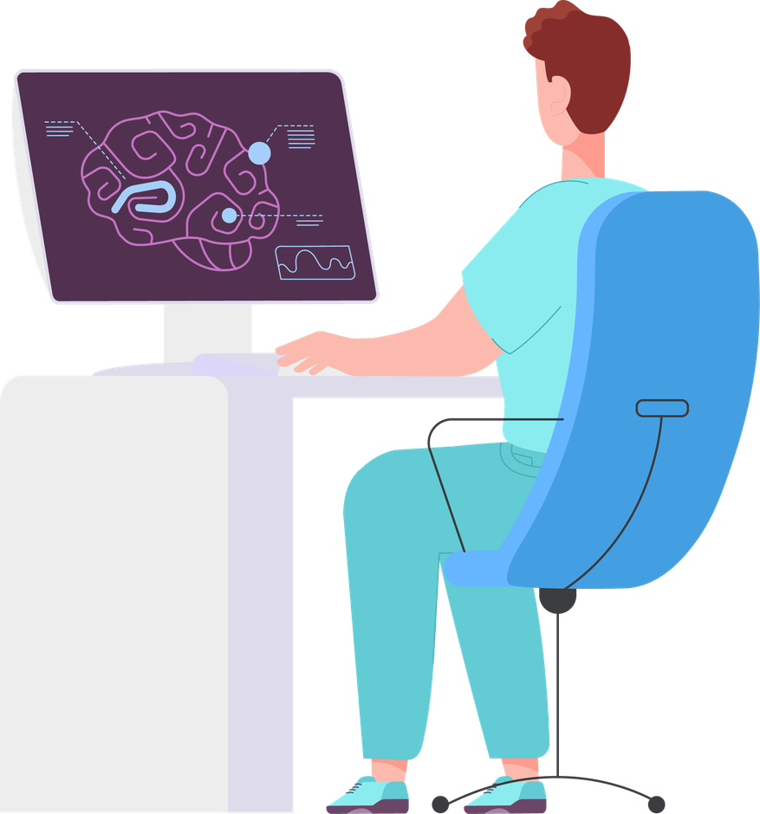
FAST DIAGNOSIS AND EARLY TREATMENT
AI systems can analyze medical data and help physicians detect diseases earlier and more accurately. Early detection is critical because it allows doctors to begin treatment sooner and improve patient outcomes.
In a new study by UCLA Health Jonsson Comprehensive Cancer Center, suggests that AI could help detect interval breast cancers-those that develop between routine screenings. They estimated incorporating AI into screening could help reduce number of interval breast cancer by 30%.

Slide 7

MEDICAL IMAGING
AI can analyze thousands of scans quickly and through AI tools can automatically highlight areas of concern in medical images like X-rays, MRIs and CT scans. These systems do not replace radiologists but instead act as supportive tools that help doctors focus their attention on the most important details and increasing efficiency by 20-40%.

Slide 8
DRUG DISCOVERY
Traditionally, developing a drug medications may require years of research and extensive testing. AI algorithms can analyze different chemical structures and biological data to predict which compound may be effective, reducing the time and cost required to bring new treatments.
Fun Fact: It can take 10-15 years to develop a drug, but AI can cut that time to almost in half!

Slide 9
PERSONALIZED MEDICINE
Personalized medicine represents another promising application of AI. By analyzing genetic information, lifestyle factors, and medical history, AI systems can help doctors design personalized treatment plans tailored to each patient. This approach has the potential to improve treatment effectiveness and reduce unwanted side effects.

Slide 10
ROBOTIC SURGERY
Surgical robots can assist doctors during complex procedures by providing enhanced precision and stability. While the surgeon remains in control, the robotic system can help perform delicate movements that might be difficult to achieve with human hands alone. This can lead to shorter recovery times and fewer complications for patients.

Slide 11
CHALLENGES AND ETHICAL ISSUES
Data privacy: Medical data is highly sensitive and protecting information is very essential, Healthcare organizations must ensure that AI systems are designed with strong security measure to prevent unauthorized access or misuse of patient data.
Algorithm bias: AI systems learn from the data used to train them. If this data is incomplete or unrepresentative, the system may produce biased results. Addressing the biases is crucial to ensure that AI technologies provide fair and reliable healthcare recommendations.
High cost: Developing, training, and maintaining advanced AI tools requires significant financial investment and technical expertise.
Ethical responsibility: When AI systems assist in making medical decisions, it is important to determine who is responsible if an error occurs.
Lack of Human Empathy: AI systems lack human emotions and understanding. They can’t provide emotional support to patients.

Slide 12
CONCLUSION
Ultimately, AI should only be viewed as a tool that enhances human expertise rather than replacing, Doctors, nurses, and medical researchers should continue to play a central role in healthcare, while AI provides additional insights and analytical capabilities. As technology continues to evolve, the collaboration between human intelligence and artificial intelligence has the potential to create a more efficient, accurate, and accessible healthcare system for people around the world.

Slide 13
REFERENCES
Ai could help improve early detection of interval breast cancers. UCLA Health. (2025, May 5). https://www.uclahealth.org/news/release/ai-could-help-improve-early-detection-interval-breast
Tanya Albert Henry Contributing News Writer Feb 26, & Tanya Albert Henry Contributing News Writer. (2025, February 26). 2 in 3 physicians are using health AI-up 78% from 2023. American Medical Association. https://www.ama-assn.org/practice-management/digital-health/2-3-physicians-are-using-health-ai-78-2023#:~:text=Physicians’%20use%20of%20health%20care,they%20used%20it%20in%202023.

Slide 14
THANK YOU!
Any Questions?

